Slide 1
Structured Query language (SQL) Presentation By - Bickramjit Basu Dated - 27.08.2024

Slide 2
SQL was invented in 1970s and was first commercially distributed by Oracle.
SQL, T-SQL, and PL/SQL: A Comparison
SQL (Structured Query Language) is the standard language for interacting with relational databases. It's used to define, manipulate, and query data.
T-SQL (Transact-SQL) is a proprietary extension of SQL developed by Microsoft for its SQL Server database. It includes additional features like procedural programming constructs, stored procedures, functions, triggers, and more. While T-SQL is primarily used with SQL Server, it shares a lot of syntax with standard SQL.
PL/SQL (Procedural Language/SQL) is another extension of SQL, developed by Oracle for its Oracle Database. It combines SQL with procedural programming constructs like variables, conditionals, loops, and exception handling. PL/SQL is often used for writing stored procedures, triggers, and functions within Oracle databases.

Slide 3
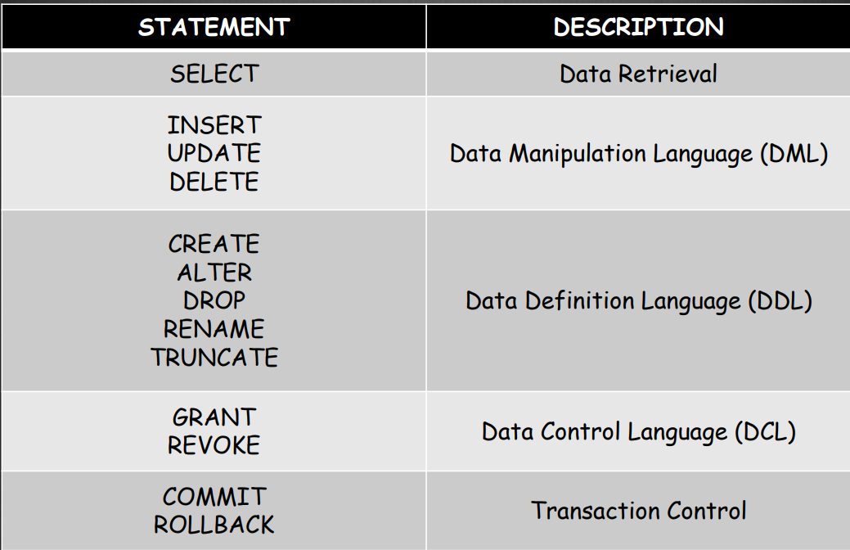
SQL Command Types
(DQL)
(TCL)

Slide 4
Delete Vs Truncate Vs Drop
DELETE | TRUNCATE | DROP
Removes specific rows or all rows from a table Data Manipulation Language (DML) Requires explicit COMMIT Can be rolled back if not committed Slower, logs each row deletion Table schema remains unchanged | Removes all rows from a table in one operation Data Definition Language (DDL) No explicit COMMIT required Cannot be rolled back Faster, does not log individual rows Table schema remains unchanged | Deletes the entire table, including data and schema Data Definition Language (DDL) No explicit COMMIT required Cannot be rolled back Fast, removes the table completely Both table data and schema are deleted

Slide 5
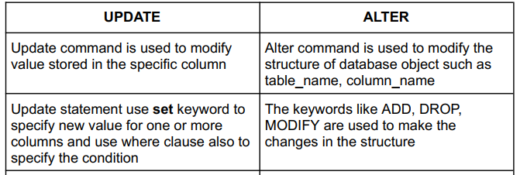
Update Vs Alter

Slide 6
CREATE table in SQL
#To create an employee table
CREATE TABLE employee(
empid int not null primary key auto_increment,
first_name varchar(25),
last_name varchar(25),
salary int(15),
joining_date datetime,
department_name varchar(25));
INSERT INTO employee (employeeid, first_name , last_name, salary, joining_date, department_name )
VALUES
('1000', ‘Prasad’, ‘Amale’ , 75000,’2023-06-16’, ‘Analtics’),
(1001,’Venkat’, ’Raj’ , 60000 , ’2023-09-27’ , ‘ Analytics’);

Slide 7
Important concepts in day-to-day SQL
NULL – In SQL, Null means no value or missing value .
BLANK – In SQL it is considered as an empty string .
ZERO – In SQL zero has a numerical value and significance .
Count(*) – In SQL, it gives the count of all rows in table .
Count(any constant) – In SQL , it gives count of all the rows in the table .
COUNT(*) and COUNT(constant) count all rows in the table, including those where columns contain NULL or blank values.
COUNT(column_name) does not include `NULL` values.
COUNT(column_name) does include blank (empty) values, as they are not `NULL`.

Slide 8
Important concepts in SQL – Part 2
Order of Execution in SQL :
1.From
2.where
3.group by
4.having
5.select
6.order by
7. limit/top
ISNULL - This function takes in 2 arguments , if the first column there is null, then the second argument replaces the null values in the column with the second argument .
COALESCE - coalesce takes multiple auguments unlike isnull() which only takes 2 arguments .
coalesce(city,state,region,'unknown’) -> here in colease function if city is null then it will take the state value ,if state is also null , then it will take the region value if all three are null then the default unknown value will be taken .

Slide 9
Keys in SQL
Primary key
Foreign key
Unique key
Candidate key
Composite key
Surrogate key
--When you make a column in the table as primary key then this column will always have unique or distinct values. Duplicate values and NULL value will not be allowed in a primary key column. A table can only have one primary key . Primary key can be created either on one single column or a group of columns.
--When you make a column in the table as unique key then this column will always have unique or distinct values . Duplicate values will not be allowed. However, NULL values are allowed in a column which has unique key constraint. This is the major difference between primary and unique key.
-- Surrogate key is a key which is synthetic key , i.e. it is a made up key (which does not comes naturally with the table) . It acts as a primary key when the primary key does not acts as a primary key .
Eg: we use Identity (1,1) to make a column in the table .

Slide 10
Constraints in SQL
Types of constrains :
1. Check (price >1) : It will allow only specific values to be entered into that column i.e. mentioned in the check.
2. Not Null : Will not allow null values .
3. Default : While creating the table we can insert a default value for that column .If we give default in the insert statement while inserting data , it will take the default value for the column .
4. Unique constraint : It will only allow unique values to be enetered into that column (for eg. order_id will have unique values only)
5. Primary_key constraint : cannot have nulls and duplicate values. We can use a combination of columns also as a primary key like .
Eg: primary key(order_id,serial_number) etc. Means a combination of these 2 columns will hold unique in each and every case .
6. Foreign Key constraint :It helps in the joining of two or more tables . Helps in maintaining referential integrity i.e. one value in a column in a table corresponds to another valid value in another table.
Eg: If you have a Orders table and a Customers table, the Orders table might have a customer_id column that serves as a foreign key referencing the customer_id column in the Customers table.

Slide 11
Indexing in SQL
Indexes in SQL are special database structures that improve the speed of data retrieval operations on a table at the cost of additional storage and maintenance overhead. An index works similarly to an index in a book: it allows the database to quickly locate and access the data without having to scan the entire table. An index created with more than one column is called a Composite Index.
There are 2 main Index types in SQL –
Clustered Index
Non-clustered Index
Data Storage: Clustered Index Alters the physical storage order of the rows in the table.Non-Clustered Index does not change the physical storage order but creates a separate structure with pointers to the data rows.
Number of Indexes: Clustered Index can be only one per table. Multiple non-clustered indexes can be created on a table.
Performance: Clustered Index are generally faster for queries that return ranges of data (e.g., range queries) because the data is physically stored in order.Non-Clustered Index are Useful for queries that filter or sort by columns not covered by the clustered index, although there’s an additional step of looking up the pointers.

Slide 12
SQL Wildcard Characters
--Selecting the names of customers where firstname starts with characters like A to E .
select * from customer where firstname like '[A-E]%'
--Selecting the names of customers where firstname that do not start with characters like B .
select * from customer where firstname like '[^B]%'
--Selecting the names of customers where firstname starts with characters like A or Z or M .
select * from customer where firstname like '[AZM]%'
--Selecting the names of customers where firstname that do not starts with characters like A or Z or M .
select * from customer where firstname like '[^AZM]%'
--Escape sequence
IF we want only those comments where there is 30% in the comment , the '%'will also be treated as a
wild card character if we give '%30%%' . So we have to use escape sequence to tell SQL engine to not consider the first % as a wild card .
Eg : select * from feedbacks where comments like '%30/%%' escape '/'

Slide 13
SQL Date Functions
DAY() - Gives the day from the date
MONTH()- gives the month from the date
YEAR() - gives the year from the date
DATEDIFF(DAY,SHIPPED_DATE,RECEIVED_DATE) - GIVES THE DIFFERENCE BETWEEN THE DATES IN TERMS OF DAYS .
DATEDIFF(MONTH,SHIPPED_DATE,RECEIVED_DATE) - GIVES THE DIFFERENCE BETWEEN THE DATES IN TERMS OF MONTHS .
DATEDIFF(HOUR,SHIPPED_DATE,RECEIVED_DATE) - GIVES THE DIFFERENCE BETWEEN THE DATES IN TERMS OF HOURS .
DATEADD(DAY,6,GETDATE()) - Adding 6 days to the current date .
DATEADD(MONTH,6,GETDATE()) - Adding 6 months to the current date .
DATEADD(DAY,-5,GETDATE()) - Subtracting 5 days from the current date.
DATENAME(WEEKDAY,ORDERDATE) - will return the name of the day from the order_date column.
DATENAME(MONTH,ORDERDATE) - will return the name of the month for ordre_date .
DATEPART(WEEK,ORDERDATE) - will return the day number from the order_date column .

Slide 14
JOINS in SQL
INNER JOIN - returns only the rows that have matching values in both tables. It excludes rows that do not have matching values.
example : SELECT columns
FROM table1
INNER JOIN table2
ON table1.common_column = table2.common_column;
LEFT JOIN / LEFT OUTER JOIN - returns all rows from the left table, and the matched rows from the right table. If no match is found, NULL values are returned
example: SELECT columns
FROM table1
LEFT JOIN table2
ON table1.common_column = table2.common_column;

Slide 15
JOINS in SQL – Part 2
RIGHT JOIN / RIGHT OUTER JOIN - returns all rows from the right table, and the matched rows from the left table. If no match is found, NULL values are returned . It is just the inverse of left join . Usually right join is not performed as the same task can be achieved using LEFT join , we just have the adjust the order of the table name in the SQL statement .
example - SELECT columns
FROM table1
RIGHT JOIN table2
ON table1.common_column = table2.common_column;
FULL JOIN / FULL OUTER JOIN – returns all rows when there is a match in either the left or right table records. Rows that do not have a match in either table will still be included, with NULL values .
example - SELECT columns
FROM table1
FULL JOIN table2
ON table1.common_column = table2.common_column;

Slide 16
JOINS in SQL – Part 3
CROSS JOIN / CARTESIAN JOIN - This join returns the Cartesian product of the two tables. It combines every row from the first table with every row from the second table. Suppose if there are 3 rows in table1 and 3 rows in table2 , then it’s cross join will return 3x3 = 9 rows.
example - SELECT columns FROM table1 CROSS JOIN table2;
SELF JOIN – Used where a table is joined with itself. It is useful when you want to find related rows within the same table.
example - SELECT a.columns, b.columns FROM table1 a, table2 b WHERE condition;
NATURAL JOIN - A Natural Join in SQL is a type of INNER JOIN that automatically joins two tables based on all columns that have the same name and data type in both tables. Unlike INNER JOIN, you don't need to explicitly specify the columns to join on.
example - SELECT Name, Dept_Name
FROM Employees
NATURAL JOIN Departments;

Slide 17
VIEWS in SQL
System-defined Views - These are views automatically created and maintained by the database system. They provide metadata information about the database's structure, objects, and settings.
Examples include INFORMATION_SCHEMA.TABLES, INFORMATION_SCHEMA.COLUMNS, sys.tables,
Inline Views - An Inline View is a subquery in the FROM clause of a SELECT statement. It acts as a temporary view within a query and is not stored in the database. Can be used to improve query performance by reducing the complexity of large queries.
Materialized Views - A view where the query results are stored physically in the database. Unlike regular views, materialized views do not need to re-run the query every time they are accessed; instead, they store the result set and can be refreshed periodically. It allows for faster query performance at the cost of storage.
Regular Views - A Dynamic View or regular view (sometimes called a logical or non-materialized view) is a type of view where It does not store the result set physically in the database but dynamically generates it each time the view is queried.

Slide 18
VIEWS in SQL – Part 2
Updatable Views - A view that allows modifications (INSERT, UPDATE, DELETE) to be propagated to the base table(s). Not all views are updatable; only those that meet certain criteria, such as being based on a single table without complex joins or aggregations, are updatable.
Simple Views - A view that is created from a single table without using complex SQL operations like joins, aggregations, or functions. It can include a subset of columns from the base table.
Complex Views - A Complex View is created from multiple tables using joins, or it involves complex SQL operations like aggregation, grouping, or functions.

Slide 19
SQL Window Functions
Window functions and their types -
1. Rank Functions ( rank, row_number,dense_rank,ntile etc.)
2. Aggregate Functions (sum, min, max, count, avg etc.)
3. Analytical functions (lead, lag, first_value , last_value etc.)
LAG - Lag will give you the value from the previous row of a column , assigned in a new column . We will see the value from the previous row .
LEAD - Lead will give you the value from next row of a column , assigned in a new column. We will see the value from the next row .
First_value()- Will give you the first value from the given column ,assigned in a new column.
Last_value() - will give you the last value from the given column, assigned in a new column.

Slide 20
SQL Window Functions – Part2
Dense_rank()- does not skip the rank if 2/3 emp having same salary and always assigns the next rank number.
Rank()- skips consicutive rank numbers if 2/3 have the same salary .
Row_Number() – Assigns a number to each row .
Ntile(2) - It is a window function which divides the data into groups of 2,3,4 etc. depending on the number given in the braces .
Sum() – Calculates the sum on a group of rows certain column .
Avg() – Calculates the average on a group of rows for a certain column .
Min() – Calculates the minimum value from a group of rows for a certain column .
Max () - Calculates the maximum value from a group of rows for a certain column .
Count() – Calculates the count of rows for a certain column .

Slide 21
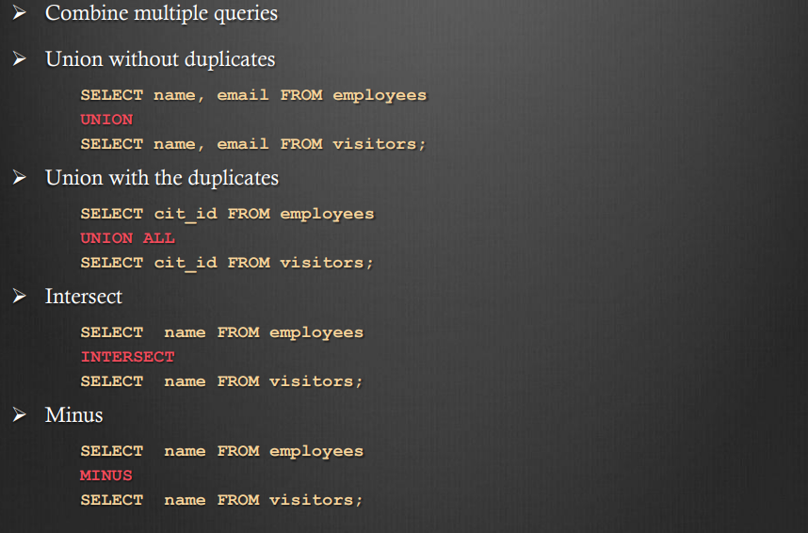
SQL SET OPERATIONS

Slide 22
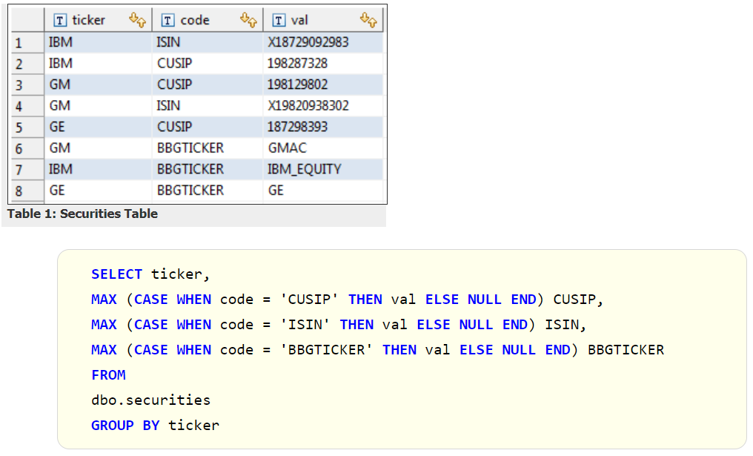
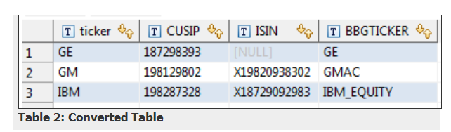
CASE statements in SQL
case
when dept_id=100 then 'Analytics'
when dept_id=200 then 'IT'
when dept_id=300 then 'HR'
else 'Ops'
end;

Slide 23
Common Table Expressions (CTEs)
CTE or Common Table Expression are temporary tables and it’s scope exists within that specific query only . CTEs are defined using the WITH clause and are particularly useful for organizing complex queries, making the code more readable, and for recursive queries.
CTE or common table expressions when called from within the CTE itself it is called Recursive CTE . It is often used for hierarchical data (like organization charts, folder structures, product hierarchy , employee hierarchy etc.) , generating a sequence etc.
You can also define multiple CTEs one after the other and reference them within the same query . Here the first CTE will start with a “WITH” clause followed up by other CTE’s which doesn’t require a “WITH” clause ; with each CTE’s being separated by comma .

Slide 24
CTE’s with Window Functions & Partition by clause
with cte as (
select category,Product_name,sum(sales) as sales_by_product
from superstore_orders
group by category,product_name)
,cte2 as
(select *,
dense_rank() over(partition by category order by sales_by_product desc) as dn_rnk
from cte)
select category,sales_by_product,dn_rnk from cte2 where dn_rnk <=5;
select *,
max(salary) over(partition by dept_id) as max_sal_by_dept,
max(salary) over(partition by dept_id order by emp_id) as max_by_emp_id from employee,
sum(salary) over(partition by dept_id order by emp_age) as rolling_sum_by_emp_age from employee;

Slide 25
User Defined Functions in SQL
User-Defined Functions or (UDFs) in SQL are custom functions that users create to perform reusable logic on database objects like tables. UDF are of the following types -
Scalar Functions: Returns a single value (scalar data type such as INT, VARCHAR, etc.) for each call.
Table-Valued Functions (TVF): Returns a table as a result.
1.Inline Table-Valued Functions: Contains a single SELECT statement that returns a table.
2.Multi-Statement Table-Valued Functions: Can include multiple statements to construct the result set.
Example: Calculating the age of a person given their birthdate .
CREATE FUNCTION dbo.CalculateAge(@BirthDate DATE)
RETURNS INT
AS
BEGIN
RETURN DATEDIFF(YEAR, @BirthDate, GETDATE())
- CASE WHEN DATEADD(YEAR, DATEDIFF(YEAR, @BirthDate, GETDATE()), @BirthDate) > GETDATE() THEN 1 ELSE 0 END;
END; Function call - SELECT dbo.CalculateAge('1990-05-15') AS Age;

Slide 26
Stored Procedures in SQL
Stored Procedure is a precompiled collection of one or more SQL statements that are stored in the database and executed as a single unit.
Stored procedures can accept input parameters, return output parameters, and can include business logic, loops, conditional statements like IF, LOOP, WHILE, etc.
Manually executed by calling EXEC .
For modular, reusable tasks that can be executed on demand.
CREATE PROCEDURE UpdateEmployeeSalary
@EmployeeID INT,
@NewSalary DECIMAL(10, 2)
AS
BEGIN
UPDATE Employees
SET Salary = @NewSalary
WHERE EmployeeID = @EmployeeID;
END;
Manually invoked using EXEC UpdateEmployeeSalary 101, 60000;

Slide 27
Triggers in SQL
Triggers are a special type of stored procedure that automatically executes in response to specific events on a table, such as INSERT, UPDATE, or DELETE. Unlike stored procedures, triggers cannot be manually executed; they are executed automatically when a specific event occurs.
Automatically enforces data integrity or performs actions on data changes
Triggers can automatically record changes made to a table in an audit log table whenever data is inserted, updated, or deleted. This is crucial for maintaining an audit trail of who made changes and when.
Triggers help cascading updates or deletes ensure that changes in one table automatically propagate to related tables to maintain referential integrity. For instance, if a record in a parent table is updated or deleted, related records in child tables are updated or deleted automatically. If an order is deleted from the Orders table, you want to automatically delete all related records from the OrderDetails table.
CREATE TRIGGER UpdateEmployeeAudit
ON Employees
AFTER UPDATE
AS
BEGIN
INSERT INTO EmployeeAudit (EmployeeID, Action, LogDate)
SELECT i.EmployeeID, 'UPDATE', GETDATE()
FROM inserted i;
END;
Automatically invoked after an UPDATE operation on the Employees table.

